Slide 1
bd
r1
r2

Slide 2
ROUND 1 CATEGORIES
Art
(1) (2) (3) (4) (5)
Kansas
(1) (2) (3) (4) (5)
Characters
(1) (2) (3) (4) (5)
General Novel Qs
(1) (2) (3) (4) (5)
What Rule Is It Anyway?
(1) (2) (3) (4) (5)
Final Question

Slide 3
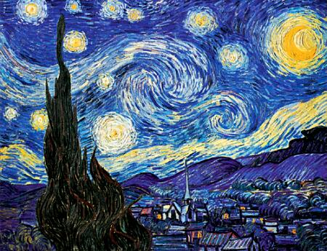
Question 1 Cat. 1
What is the name of this Van Gogh painting?

Slide 4
Answer 1 Cat. 1
Home
Starry Night

Slide 5
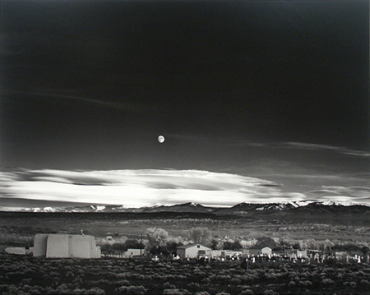
Question 2 Cat. 1
What famous photographer captured this night sky in Moonrise over Hernandez, NM on October 31, 1941

Slide 6
Answer 2 Cat. 1
Home
Ansel Adams

Slide 7
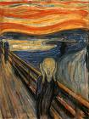
Question 3 Cat. 1
Whose The Scream is this?

Slide 8
Answer 3 Cat. 1
Home
Edvard Munch

Slide 9
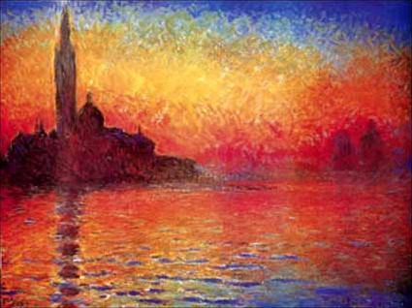
Question 4 Cat. 1
What impressionist painted
Venice Twilight?

Slide 10
Answer 4 Cat. 1
Home
Claude Monet

Slide 11
Question 5 Cat. 1
Whose work is this?

Slide 12
Answer 5 Cat. 1
Home
Pablo Picasso

Slide 13
Question 1 Cat. 2
What is the name of the town in Kansas where Superman lived on Earth?

Slide 14
Answer 1 Cat. 2
Home
Smallville

Slide 15
Question 2 Cat. 2
What is the Kansas state song written in 1947 and written by Dr. Brewster Higley?

Slide 16
Answer 2 Cat. 2
Home
Home on the Range

Slide 17
Question 3 Cat. 2
What is the name of the state’s highest point?

Slide 18
Answer 3 Cat. 2
Home
Mount Sunflower

Slide 19
Question 4 Cat. 2
What is the state insect, adopted in 1976?

Slide 20
Answer 4 Cat. 2
Home
Honeybee

Slide 21
Question 5 Cat. 2
Edmund G. Ross of Kansas cast the deciding vote for acquittal in the impeachment trial of what US president?

Slide 22
Answer 5 Cat. 2
Home
President Andrew Johnson in 1868

Slide 23
Question 1 Cat. 3
In Animal Farm who repeats, “Four legs good, two legs bad”?

Slide 24
Answer 1 Cat. 3
Home
The sheep

Slide 25
Question 2 Cat. 3
What character from Animal Farm quickly takes control over the other animals?

Slide 26
Answer 2 Cat. 3
Home
Napoleon

Slide 27
Question 3 Cat. 3
In Animal Farm who says, “I will work harder” and “Napoleon is always right”?

Slide 28
Answer 3 Cat. 3
Home
Boxer

Slide 29
Question 4 Cat. 3
What character in Animal Farm first has the dream of a farm with no humans and equal animal rights?

Slide 30
Answer 4 Cat. 3
Home
Old Major

Slide 31
Question 5 Cat. 3
In Animal Farm who says, “If you have your lower animals to contend with, we have our lower classes”?

Slide 32
Answer 5 Cat. 3
Home
Mr. Pilkington

Slide 33
Question 1 Cat. 4
What country is Animal Farm set in?

Slide 34
Answer 1 Cat. 4
Home
England

Slide 35
Question 2 Cat. 4
True or False:
Snowball helps Jones when he attempts to take back the farm.

Slide 36
Answer 2 Cat. 4
Home
False: Snowball leads the charge against Jones.

Slide 37
Question 3 Cat. 4
What is the original name of Animal Farm?

Slide 38
Answer 3 Cat. 4
Home
Manor Farm

Slide 39
Question 4 Cat. 4
Who writes “Animal Farm, Animal Farm” to replace “Beasts of England?”

Slide 40
Answer 4 Cat. 4
Home
Minimus

Slide 41
Question 5 Cat. 4
What are the names of the two farms that neighbor Animal Farm?

Slide 42
Answer 5 Cat. 4
Home
Foxwood and Pinchfield.

Slide 43
Question 1 Cat. 5
What is the rule Old Major devises to tell friend from foe?

Slide 44
Answer 1 Cat. 5
Home
Creatures that walk on two legs are enemies; those with four legs or with wings are allies.

Slide 45
Question 2 Cat. 5
Who explains why the pigs stay in the house?

Slide 46
Answer 2 Cat. 5
Home
Squeeler

Slide 47
Question 3 Cat. 5
Name one of the original rules in Animal Farm and how it changed?

Slide 48
Answer 3 Cat. 5
Home
Answers will vary.

Slide 49
Question 4 Cat. 5
Who eats the apples?

Slide 50
Answer 4 Cat. 5
Home
Napoleon

Slide 51
Question 5 Cat. 5
What is the last rule written on the barn in Animal Farm?

Slide 52
Answer 5 Cat. 5
Home
All animals are equal, but some animals are more equal than others.

Slide 53
Round 1 Lightening
Home
Tell me whether this is a rule or not in Animal Farm.

Slide 54
Home
Whatever goes on four legs is an enemy.

Slide 55
Home
No

Slide 56
Home
No animal shall wear clothes.

Slide 57
Home
yes

Slide 58
Home
No animal shall drink.

Slide 59
Home
No

Slide 60
Home
No animal shall wear shoes.

Slide 61
Home
No

Slide 62
Home
All animals are equal.

Slide 63
r1
r2
Home
Yes.

Slide 64
r1
Home
r2
No animal shall kill any other animal.

Slide 65
r1
Home
r2
yes

Slide 66
r1
Lets get started with our first Lightning Round
r2

Slide 67
Home
Final Question:
Final wagers…

Slide 68
Home
Final Question:
You have 45 seconds…

Slide 69
Home
Final Question:
What are the modified last rules?

Slide 70
Home
Final Question:
* No animal shall sleep in a bed with sheets * No animal shall drink alcohol to excess * No animal shall kill any other animal without cause. * All animals are equal, but some animals are more
equal than others.

